Slide 1
UC College of Medicine Center for Addiction Research (CAR) Summer Speaker Series
Sponsored by: Urban Health Pathway of Next Lives Here
August 17, 2022
12:00 – 1:00PM
This event is being recorded.

Slide 2
Center for Addiction Research (CAR)
The CAR was launched in October of 2020
Mission: to support cross-disciplinary collaborations across UC as well as with community partners, governmental institutions, and other academic institutions in order to accelerate scientific progress in addiction prevention and treatment
Twenty-seven faculty from four UC Colleges
CAR Website: https://med.uc.edu/institutes/CAR/home

Slide 3
CAR Website
Publications: https://med.uc.edu/institutes/CAR/publications
Projects:
https://med.uc.edu/institutes/CAR/projects
Communications:
https://med.uc.edu/institutes/CAR/communications
To become an affiliate member:
https://med.uc.edu/institutes/CAR/car-member-registration

Slide 4
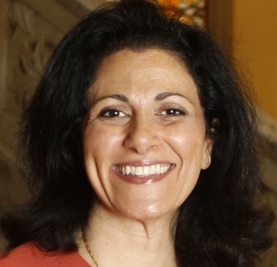
The COM CAR Summer Speaker Series
Sponsored by Urban Health Pathway of Next Lives Here
Thank you to the Planning Committee:
Dena Cranley
Jen Rowe

Slide 5
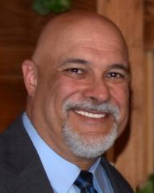
The COM CAR Summer Speaker Series
Special thank you for operational assistance from:
Jermaine Fields – UC IT User Interface and User Experience Developer
Todd Schutter - Multi-Media Coordinator, UC Information Technology

Slide 6
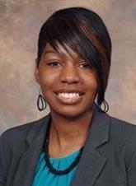
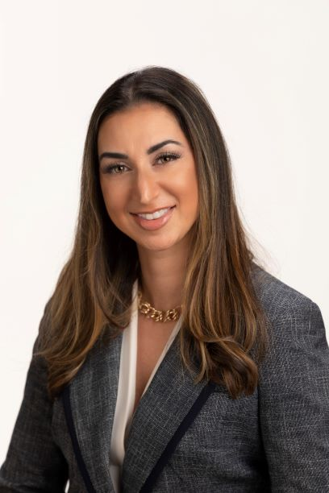
Understanding and Impact of Medical Marijuana in Ohio
LaTrice Montgomery, PhD
University of Cincinnati
Andrea Steel,
Frost Brown Todd Attorneys, LLC

Slide 7
Learning Objectives
Provide a brief overview of medical marijuana program in Ohio.
Describe the health effects and social impact of medical marijuana use among patients in Ohio.
Discuss medical marijuana laws and implications for patients and healthcare providers.

Slide 8
Ohio Medical Marijuana Control Program
House Bill 523—Effective 9/8/2016
Ohio is the 25th state to legalize medical marijuana
Program fully operational—1/16/2019
Ohio Medical Marijuana Control Program (OMMCP), https://medicalmarijuana.ohio.gov/

Slide 9
Regulatory Oversight
State of Ohio Board of Pharmacy
-Oversee MM retail dispensaries, the registration of MM patients and caregivers, the approval of new forms of MM and coordinating the MM Advisory Committee
State Medical Board of Ohio
-Certify physicians to recommend MM and may add to the list of qualifying conditions
Ohio Department of Commerce
-Oversee MM cultivators, processors and testing laboratories

Slide 10
Ohio Medical Marijuana Process Flow Chart

Slide 11
Ohio Qualifying Conditions/Diseases
AIDS
Amyotrophic lateral sclerosis
Alzheimer’s Disease
Cachexia
Cancer
Chronic Traumatic Encephalopathy
Crohn’s Disease
Epilepsy or another seizure disorder
Fibromyalgia
Glaucoma
Hepatitis C
Huntington’s Disease
Inflammatory Bowel Disease
Multiple sclerosis
Pain—chronic and severe or intractable
Parkinson’s disease
Positive status for HIV
Post-traumatic stress disorder
Sickle cell anemia
Spasticity
Spinal cord disease or injury
Terminal Illness
Tourette’s syndrome
Traumatic brain injury
Ulcerative colitis

Slide 12
Ohio Program Update (As of 7/25/22)
58 Certificates of Operation (Dispensaries)
526,255 Recommendations (Patients)
285,621 Registered Patients
265,520 Unique Patients Who Purchased Medical Marijuana (as reported to OARRS by licensed dispensaries)
30,175 Registered Caregivers
641 Certificates to Recommend (Physicians)

Slide 13
Behind the Scenes
Adult patients enrolled in the OMMCP (N = 19)
1-hour individual virtual interviews
Questions about health, social network and support, employment and experiences with the program

Slide 14
Health Experiences
Chronic Pain
PTSD
Fibromyalgia
Multiple Conditions
Employment
Lack of disclosure
Policy recommendations
Social Network and Support
Stigma
Online forums and groups
Importance of caregivers
Experiences with OMMCP
Hesitant to discuss with PCP & other providers
Heavy reliance on telehealth, online ordering
Product research
Barriers: cost, travel, product availability

Slide 15
Andrea Steel,
Frost Brown Todd Attorneys, LLC

Slide 16
Discuss Medical Marijuana Laws and Implications for Patients and Healthcare Providers
Laws To Be Aware of – General Public & Medical Professionals
Hemp v. Marijuana
Ohio Medical Marijuana v. Other States
What May Be Coming Next?

Slide 17
Laws To Be Aware Of – General Public & Medical Professionals
Marijuana is federally illegal as a Schedule 1 Controlled Substance
DOJ-issued Cole Memo (2013) was rescinded in 2018 but essentially remains effective in practice under US Attorney General M. Garland
Federally-assisted housing, bankruptcy, federal tax, and immigration do not have carveouts for medical marijuana

Slide 18
Laws To Be Aware Of – General Public & Medical Professionals (cont’d)
Health Law Considerations
Patients
Caregivers
Physicians
Concealed Carry / Gun Possession
Criminal Law Exceptions
Employer Protections
Other Considerations

Slide 19
Hemp v. Marijuana
Difference between hemp v. marijuana
“hemp” means the plant Cannabis sativa L. and any part of that plant, including the seeds thereof and all derivatives, extracts, cannabinoids, isomers, acids, salts, and salts of isomers, whether growing or not, with a delta-9 tetrahydrocannabinol concentration of not more than 0.3% on a dry weight basis.
Legalities Beyond Criminal – FDA Position
Hemp-derived cannabinoid market
Competition between markets

Slide 20
Ohio Medical Marijuana v. Other States
Surrounding States
Kentucky & Indiana
Pennsylvania & West Virginia
Michigan
Medical Regimes
Vertical integration v. tiered licensing
License caps
Qualifying conditions
THC caps

Slide 21
What May Be Coming Next?
Federally
Secure and Fair Enforcement (SAFE) Banking Act
Cannabis Administration and Opportunity Act (CAOA)
2023 Farm Bill
Ohio
Medical Marijuana Expansion
Adult-Use

Slide 22
Andrea Steel Contact Info
Email: asteel@fbtlaw.com
Direct: (713) 590-9346
Mobile: (281) 755-3850
LinkedIn: Andrea (Jaffe) Steel https://www.linkedin.com/in/andrea-steel-77b96b/

Slide 23
Q&A
Please unmute to ask a question OR type your question in the chat box.

Slide 24
Thank you for joining us!
Please take a few moments to complete
the survey form. The survey link is provided
in the chat box.
The form is required to complete if requesting CE credit for Psychology, Social Work, or Counseling.

Slide 25
All Summer Speaker Series event recordings can be found by visiting
the CAR website.
Thank you for attending!
med.uc.edu/institutes/CAR/summer-speaker-series/speaker-series-2022

