Slide 1
Rethinking TIA and Minor Stroke
S. Claiborne Johnston, MD, PhD
Dell Medical School
University of Texas, Austin

Slide 2
Potential Conflicts of Interest
Principal investigator for the POINT trial, sponsored by the NIH but with drug and placebo contributed by Sanofi-Aventis.
Principal investigator of the SOCRATES trial, testing ticagrelor vs. aspirin in stroke/TIA, sponsored by AstraZeneca.

Slide 3
TIA and Minor Stroke are Different from More Severe Stroke
Patients with TIA and minor stroke do not have major impairment.
  Acuity?
Pathophysiology is different
  Greater instability
  Lower risk of hemorrhage

Slide 4
The Agenda
Prognosis
  Scores
  Imaging
Pathophysiology
Guidelines and Proven Management Strategies
Aggressive Treatment

Slide 5
Prognosis

Slide 6
TIA: Short-Term Prognosis
Many studies on prognosis, but the immediate period after TIA is often ignored
California ED TIA Study
  All Kaiser-Permanente enrollees (N=1,707) given a diagnosis of TIA in the emergency department
  March 1997 – February 1998
  Follow-up from record review for 3 months after presentation.
Johnston et al, JAMA 2000;284:2901

Slide 7
Kaplan-Meier survival estimates, by dup
1
Strokes
.9
.8
Adverse Events
Probability of Survival
.7
.6
0
7
30
60
90
Days after TIA
No. of Patients
At Risk For:
St
roke
1001 1577
1527
1480
1451
Adverse Events
1001 1462
1361
1293
1248
Johnston et al, JAMA 2000;284:2901

Slide 8
ABCD² Score
Score points for each of the following:
  Age >60 (1)
  Blood pressure >140/90 on initial evaluation (1)
  Clinical:
    Focal weakness (2)
    Speech impairment without weakness (1)
  Duration
    >60 min (2)
    10-59 min (1)
  Diabetes (1)
Final Score 0-7
Johnston et al, Lancet, 369:283, 2007

Slide 9
ABCD² Score and Stroke Risks
Johnston et al, Lancet, 369:283, 2007

Slide 10
New Infarction and Stroke Risk
New infarct on CT as a predictor of stroke:
  38% with new infarct had a stroke within 90 days vs. 10% without (p=0.008).
  OR 4.1 after adjustment for clinical factors.
New infarct on MRI also shown to be a predictor.
  5-fold increase in risk with new lesion on baseline MRI
  Also, greater risk of in-hospital stroke in a second cohort.
VC Douglas et al, Stroke 2003; 34:2894
SB Coutts et al, Neurology 2005; 65:513
H Ay et al, Ann Neurol 2005; 57:679

Slide 11
Large-Artery Stenosis or Occlusion
Large-vessel stenosis/occlusion associated with greater risk
  OR 3.5 in Barcelona (similar for intra- and extra-cranial disease)
  OR 7.9 in Calgary for intracranial occlusion
  HR 3.4 in Paris for large artery atherosclerosis
Ois et al, Stroke 2008; 39:1717
Coutts SB et al, Int J Stroke, 3:3, 2008
Calvet D et al, Stroke 40:187, 2009

Slide 12
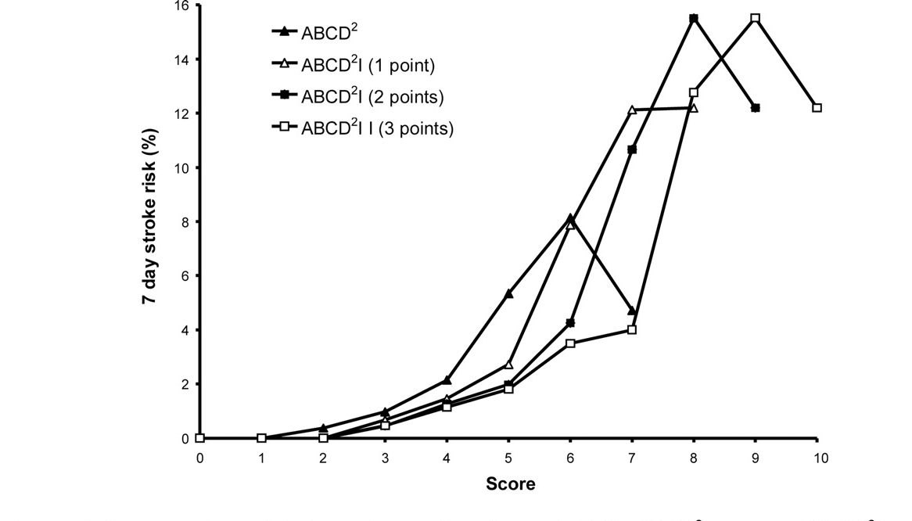
Imaging Plus ABCD²
ABCD² I
  ABCD² + DWI /CT infarct (3 pt)
  C statistic 0.78 vs. 0.66 for ABCD² alone
Giles MF, Stroke, 41:1907, 2010

Slide 13
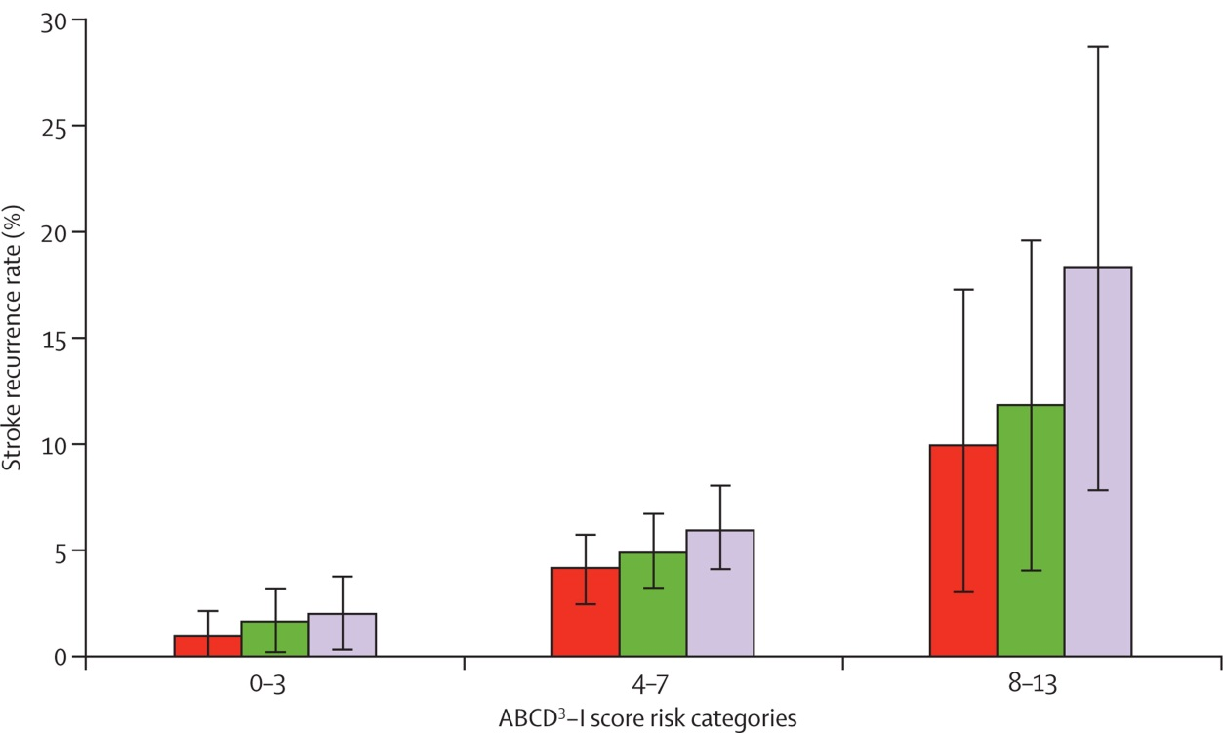

Imaging Plus ABCD²
ABCD³ I
  ABCD² + Dual TIA (2 pt) + DWI infarct (2 pt) + carotid stenosis (2 pt)
  C statistic 0.71 vs. 0.60 for ABCD² alone
Kelly PJ, Lancet Neurol, 9:1060, 2010

Slide 14
How Do the Scores Work?
Neurologist-confirmed TIAs have higher ABCD² scores
ABCD² also associated with presence of DWI-positive lesion on MRI
Scores likely work in part by identifying who has had a true TIA
  Without scores, little agreement, even among neurologists (kappa 0.25-0.65)
ABCD² is less predictive in those with minor stroke, with blood pressure and diabetes the only predictive elements.
Josephson et al, Stroke, 39:3096, 2008
Chandratheva A, et al. Stroke, 42:632, 2011

Slide 15
Guidelines and Prognostic Scores
AHA: It reasonable to hospitalize patients with ABCD² ≥3 presenting within 72 hours of symptoms, or with lower scores if workup cannot be done as an outpatient within 2 days or if there is other evidence for focused ischemia.
NICE: Evaluation by specialist within 24 hours for scores >4.

Slide 16
Recommendations on Scores
Consider the following high risk:
  ABCD² > 3
  Acute infarction on MRI or CT
  Ipsilateral large vessel stenosis/occlusion
  Others who worry you (e.g., endocarditis, crescendo events, hypercoagulable)

Slide 17
Stroke Risk After TIA
Year N Stroke Risk
Johnston, et al (Kaiser ED) 2000 1707 10.5%/90d
Eliasew, et al (NASCET) 2004 603 20.1%/90d
Lovett, et al (Oxfordshire) 2004 209 12%/30d
Gladstone, et al (Toronto) 2004 371 5%/30d (readm)
Daffertshofer, et al (Grmy) 2004 1150 13%/180d
Hill, et al (Alberta) 2004 2285 9.5%/90d
Lisabeth, et al (Texas) 2004 612 4.0%/90d
Kleindorfer, et al (Cinc) 2005 927 14.6%/90d
Whitehead, et al (Scotland)2005 205 7%/30d
Correia, et al (Portugal) 2006 141 13%/7d
Tsivgoulis, et al (Greece) 2006 226 9.7%/30d
Purroy, et al (Spain) 2007 345 4.9%/7d
AVERAGE ~12% stroke risk in 90 days after TIA
5% in first 2 days

Slide 18
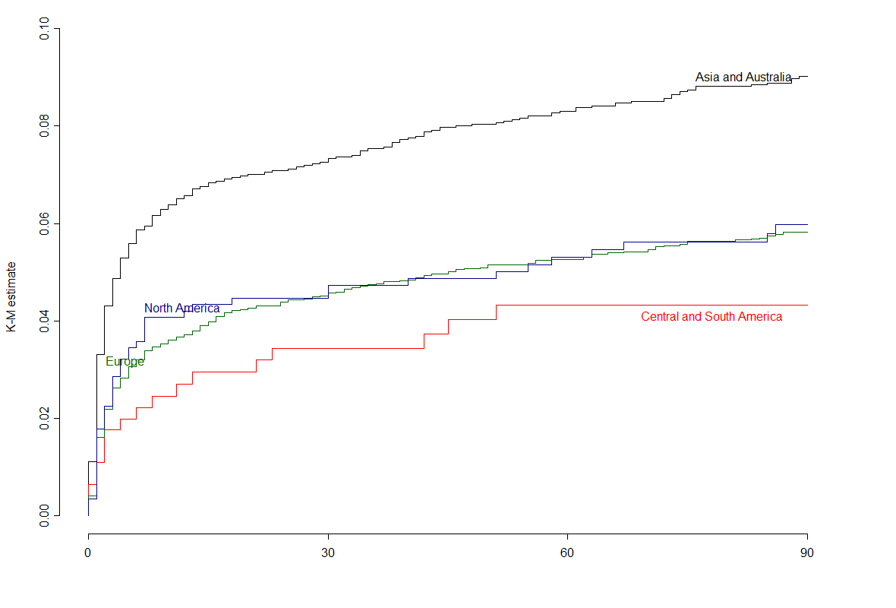
Event rate by region
Region | N | Events | Adjudicated events | KM% | 95% CI
Asia and Australia (China included) | 4243 | 351 | 181 | 8.9% | (8.0%, 9.8%)
China | 928 | 90 | 16 | 11.2% | (8.7%, 13.7%)
Central and South America | 463 | 18 | 12 | 4.2% | (2.2%, 6.2%)
Europe | 5414 | 300 | 189 | 5.9% | (5.2%, 6.6%)
North America | 873 | 47 | 31 | 5.9% | (4.2%, 7.5%)
18

Slide 19
Stroke Risk After Stroke
IST 3.3 %/ 3m
CAST 1.6%/ 3m
TOAST 5.7%/ 3m
NASCET 2.3%/3m
AVERAGE ~4% stroke risk in 90 days after stroke

Slide 20
pathophysiology

Slide 21
Pathophysiology
Short-term risk of stroke:
  After TIA (12%) > after stroke (4%)
Possible explanation
  Tissue still at risk: unstable situation
    More thrombo-embolic events
    Events more apparent
Johnston, NEJM 2002; 347:1687

Slide 22
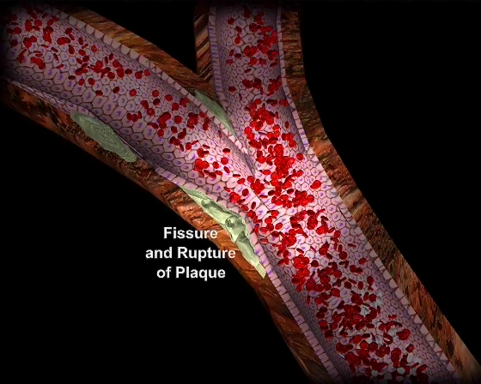
Possible Explanation: Instability

Slide 23
The Case for Urgency
Events can only be prevented if you act before they occur.
Urgency in:
  Evaluation
  Initiation of proven therapies
  Initiation of aggressive treatment
  Hospitalization

Slide 24
Guidelines and proven management strategies

Slide 25
Guideline Recommendations:
Evaluation
Urgent evaluation: usually emergency department.
ECG.
Routine labs.
Head imaging (CT or MRI)
Carotid imaging.
Observation for high risk patients.

Slide 26
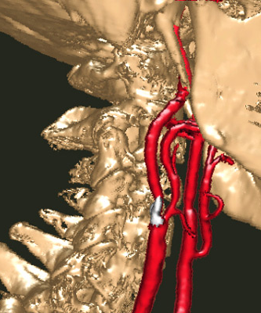
Carotid Artery Atherosclerosis
Accounts for about 11% of TIAs.
Short-term stroke risk appears to be greater
  20% at 90-days in one study

Slide 27
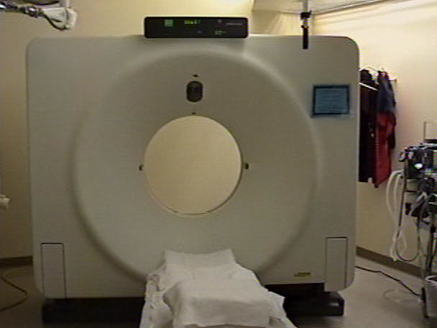
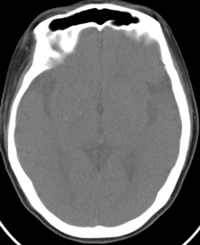

0
min
5
10
15
Patient Arrives in CT
Non-contrast CT Head
CT Perfusion (40 cc contrast)Twice
CTA brain to chest (70 cc contrast)
Positioned

Slide 28
Importance of Timing
Absolute risk reduction at 5 y for stroke or operative death:
  >50%, < 2 weeks: 20%
  >50%, >=2 weeks: 0.8%
NSA Guidelines: Endarterectomy recommended as soon as possible (preferably within 2 weeks) for those with symptomatic 70-99% stenosis and for those with 50-69% who can be treated with <6% risk of perioperative stroke or death.
Rothwell PM et al, Lancet. 2004 363:915-24
Johnston et al, Ann Neurol 2006 60:301-13

Slide 29
Guideline Recommendations:
Treatment
Start an antiplatelet agent immediately
  Aspirin, clopidogrel, aspirin-dypiridamole all acceptable alternatives.
  OR anticoagulation for atrial fibrillation.
Start a statin.
Start an antihypertensive agent.
Treat diabetes if present.
Treat carotid disease as soon as possible.

Slide 30
Initiation of Proven Therapies
Most patients do not receive proven treatment, such as statins, BP control, endarterectomy
EXPRESS Study
  Before-after comparison with an urgent TIA clinic in Oxford
  80% reduction in stroke risk after TIA/stroke
Parisian TIA clinic: similar low rates
Rothwell PM et al, Lancet 2007 370:1432
Lavallee PC et al, Lancet Neurol 2007 6:953

Slide 31
aggressive treatment?

Slide 32
Timing and Clopidogrel-Aspirin

Slide 33
Rationale of Three Large-Scale Trials:
CHANCE, POINT & SOCRATES
Treat TIA as an acute condition
  Begin treatment rapidly (within 12-24 hours)
Choose an agent that is likely to be effective regardless of underlying cause
  Clopidogrel, on background of aspirin
  Ticagrelor vs. aspirin

Slide 34

CHANCE Trial
Randomized, double-blind, placebo controlled trial of acute TIA or minor ischemic stroke
  Clopidogrel (300 load then 75/day) vs. placebo x21 days
  Background aspirin at dose 75/day
Inclusion criteria:
  TIA (classic def) <24 hours, ABCD²>4
  OR, minor ischemic stroke with NIHSS<3
Outcome: 90-day stroke rate
5170 patients at 114 centers in China

Slide 35
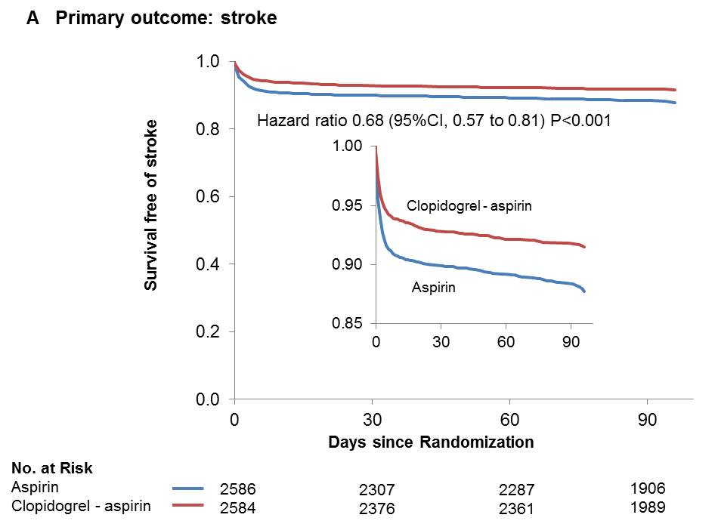
CHANCE Primary Outcome: Stroke

Slide 36
Safety outcomes
Outcomes | Aspirin (N=2586) |  | Clopidogrel-Aspirin (N=2584) |  | P Value
 | Event No. | Event Risk | Event No. | Event Risk
Any Bleeding | 41 | 1.6% | 60 | 2.3% | 0.09
Severe Bleeding | 4 | 0.2% | 4 | 0.2% | 0.93
Moderate Bleeding | 4 | 0.2% | 3 | 0.1% | 0.68
Mild Bleeding | 19 | 0.7% | 30 | 1.2% | 0.13
Death from any cause | 10 | 0.4% | 10 | 0.4% | 0.94

Slide 37

POINT Trial
Similar trial in the US, Canada, and several other countries.
Sponsored by US NIH.
DSMB recommended continuing trial.

Slide 38

SOCRATES Trial
Ticagrelor vs. aspirin in the US, Canada, and multiple other countries.
Ticagrelor = reversible directly binding P2Y12 inhibitor.
Sponsored by AstraZeneca.

Slide 39
Enrollment
>$500M
$45M

Slide 40
Cost per
new drug
Munos B Nat Rev Drug Disc 2009; 8: 959-68; Tufts Center for Study of Drug Development, 2014

Slide 41
Conclusions
TIAs and minor ischemic strokes are ominous
  Justifies acute interventions, including hospitalization
  Opportunity to prevent injury but trials are needed
Scores may help with prognostician but they are far from perfect
Secondary prevention is key
  Carotids should be treated right away
  Proven treatments should be started immediately
We need more trial results
We need better mechanisms for trials

Slide 43
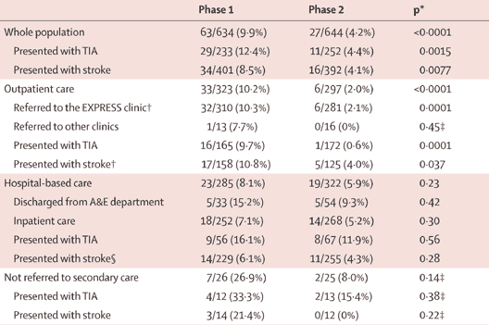
EXPRESS Study Results
Half of patients treated with clopidogrel-aspirin in phase 2

Slide 44
What about hospital admission?
Is it cost effective to admit a patient with recent TIA solely for observation and the potential to give tPA more rapidly and frequently?
  TIA within last 24 hours.
  Only those who would be candidates for tPA if they had a stroke.
Nguyen-Huynh et al, Neurology. 2005 65:1799-1801

Slide 45
Results
No Admit Admit Net
Hospitalization costs $0 $696
New stroke 4.2% 4.2%
tPA usage with stroke 8.2% 53.3%
Proportion getting tPA 0.3% 2.2%
Cost (savings) ($20) $568 $588
QALY 0.002 0.013 0.011
Net $/QALY: $55,044
Nguyen-Huynh et al, Neurology. 2005 65:1799-1801

Slide 46
Hospitalization?
24-hour hospitalization of TIA may be cost-effective solely on the basis of increased tPA use.
  Results are sensitive to a number of variables.
However, there may be other benefits to hospitalization
  More rapid work-up.
  Cardiac monitoring.
  More reliable initiation of treatment.
NSA Guidelines: Hospitalization recommended if high risk for stroke (eg, by validated scoring systems) or requiring special treatment (eg, carotid stenosis or atrial fibrillation).
  Translate: ABCD² score 6-7 → definite; 4-5 → probably

